Slide 1

Graduation Internship Mid-Term Review
Edita Pronckute @Drieam

Slide 2
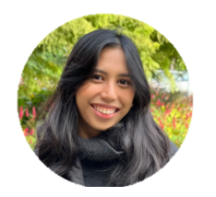
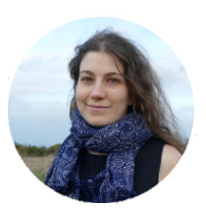
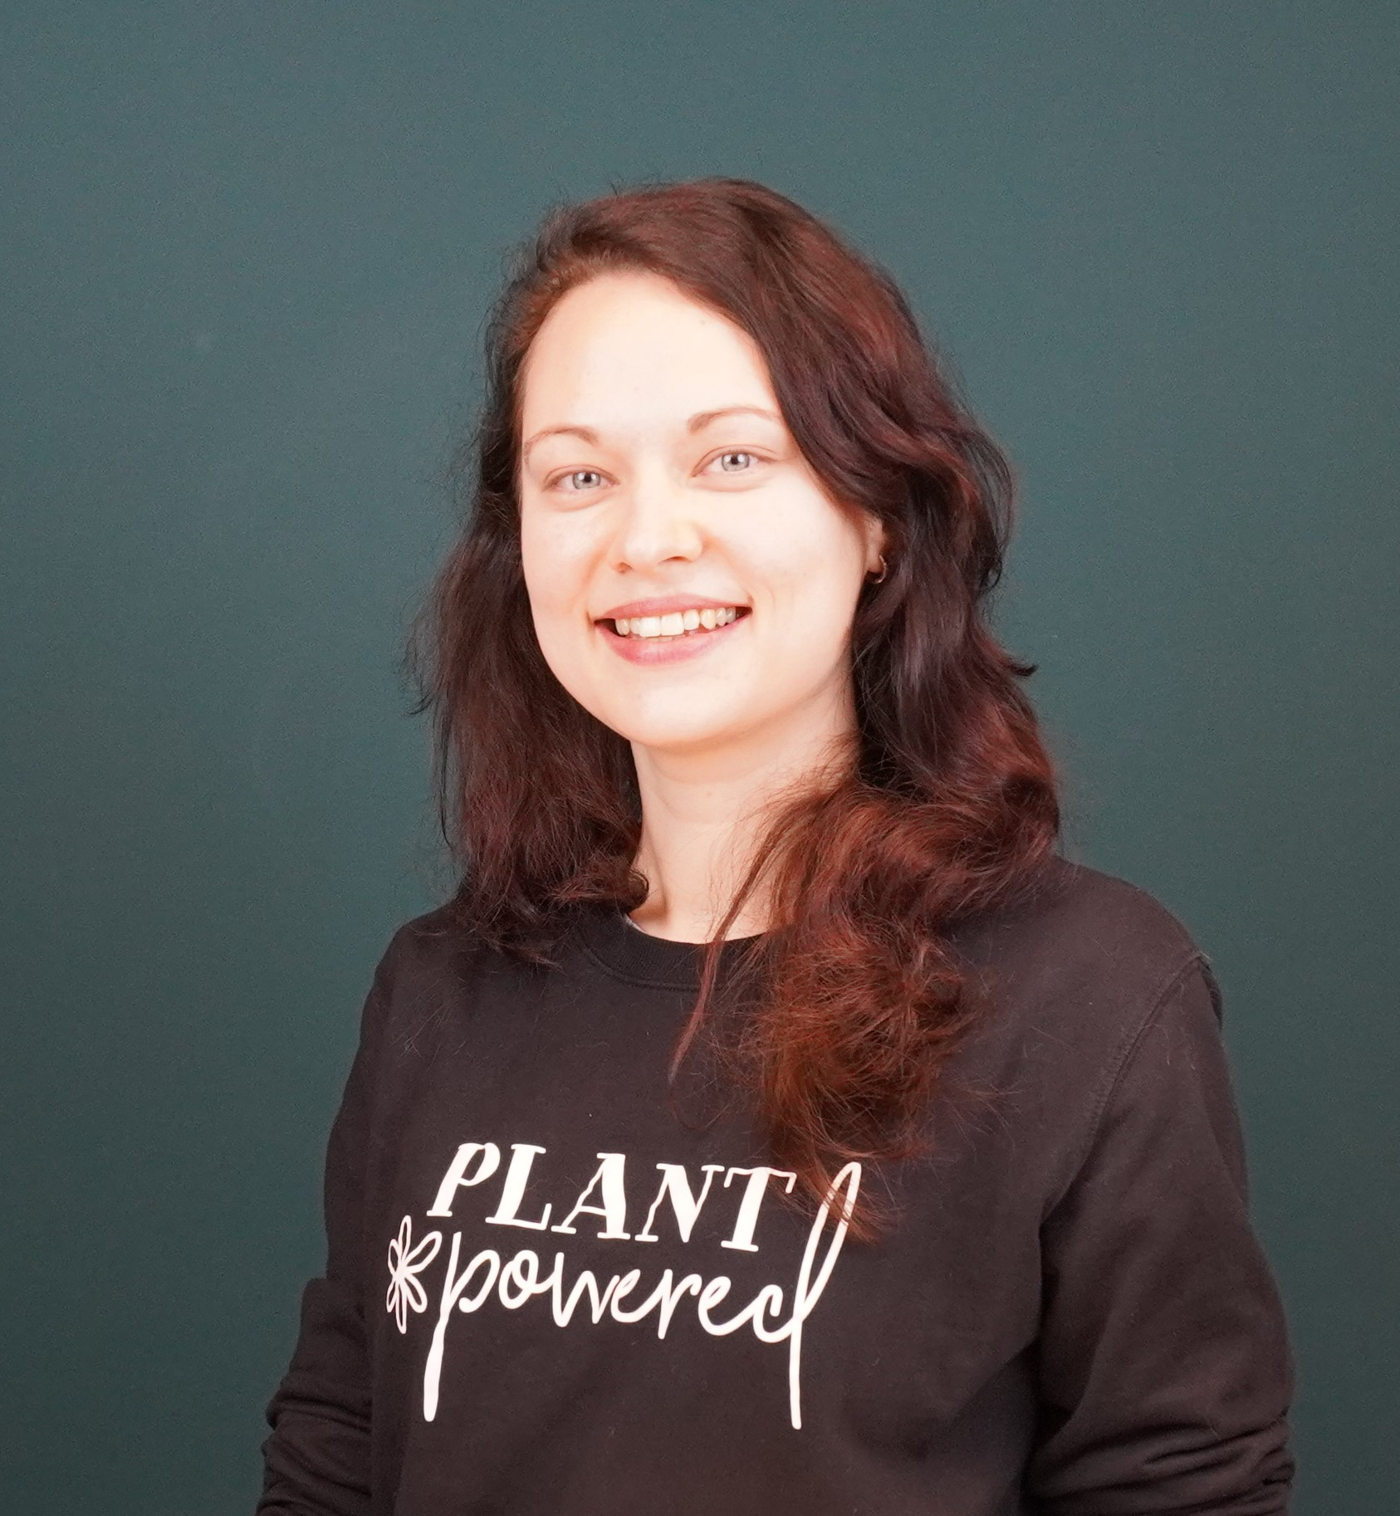
My mentors and I
ABOUT US
Ellya Aisyah
Mentor / Frontend Developer
Coline
Mentor Fullstack Developer
Edita Pronckute
Intern

Slide 3
The Company

Slide 4

About Drieam
Fast growing EdTech scale-up from Europe
50+ colleagues with focus on product development, user experience & consultancy
Focus on higher education and continuing education
Instructure Partner for 5+ years, working exclusively with Canvas as LMS.

Slide 5






Slide 6
The Assignment

Slide 7
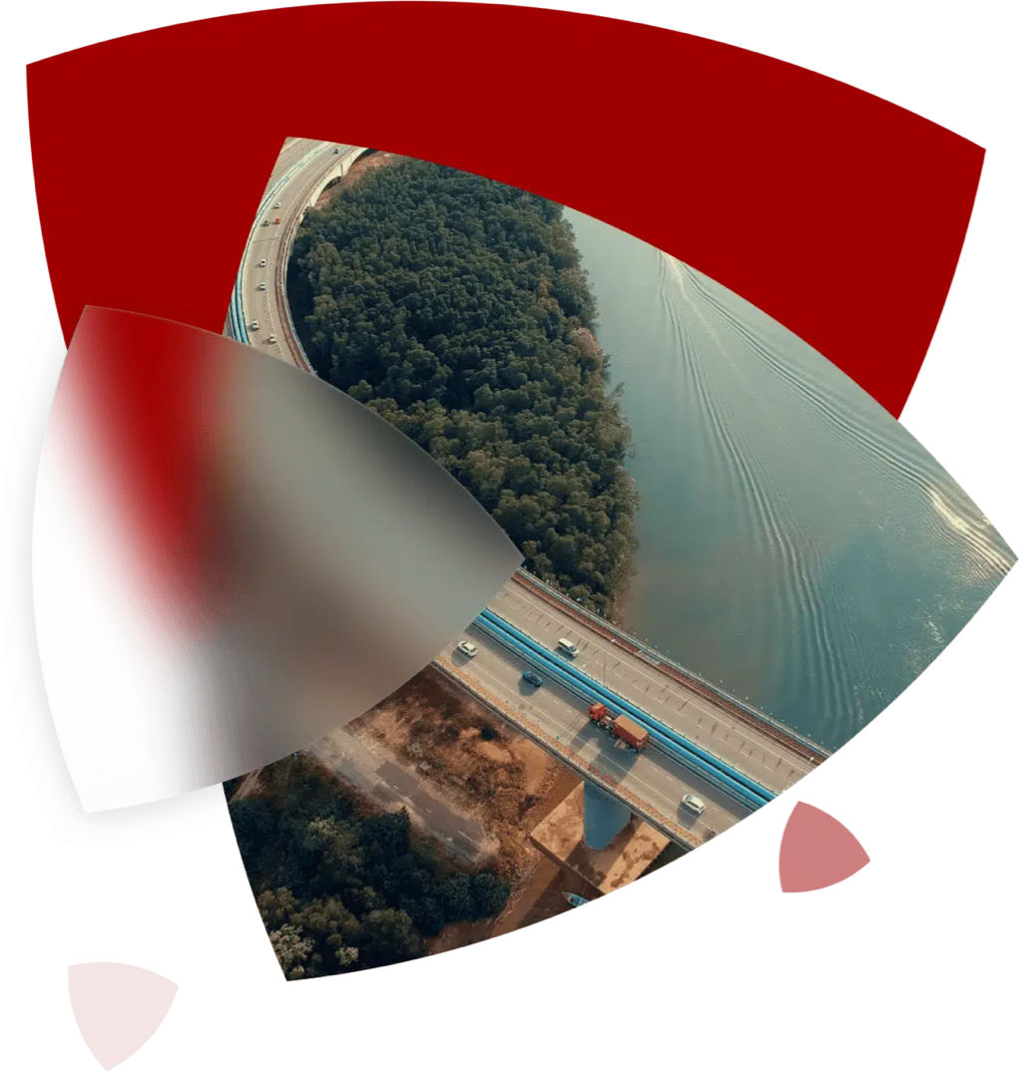

Context & Opportunity
Portflow is one of many Drieam’s products. It is a digital portfolio where students can showcase their study evidence to teachers. Evidence could be various files, assignments, demos, presentations.

Slide 8
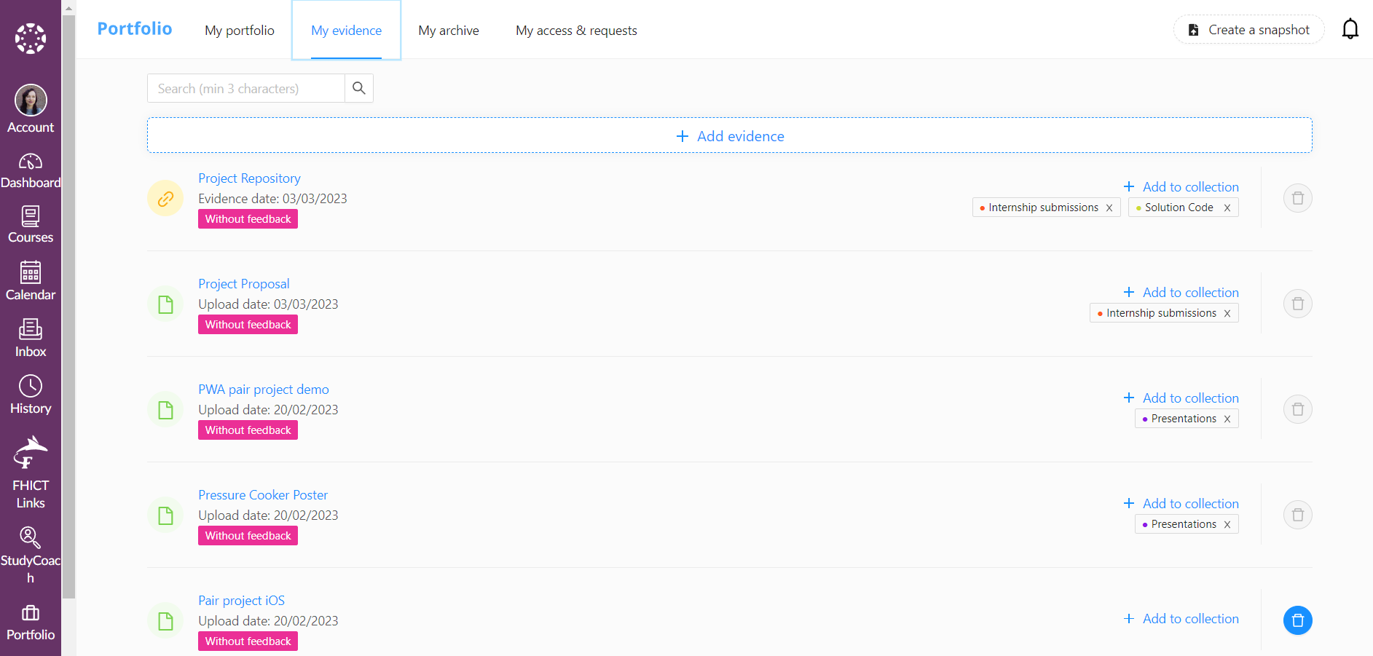
Current Look

Slide 9
The Progress

Slide 10



Research and Analysis
Understand the assignment
Feedback from peers and colleagues
Draft project plan
Practice new frameworks
Gather requirements
Design
Design Document
Gather inspiration
Talk to PO & UX designers
Sketch potential solutions Create wireframes
Pitch THE solution
Development and Deployment
Refinement session
Implementation
Testing and deployment Project Report
Mid-term evaluation

Slide 11
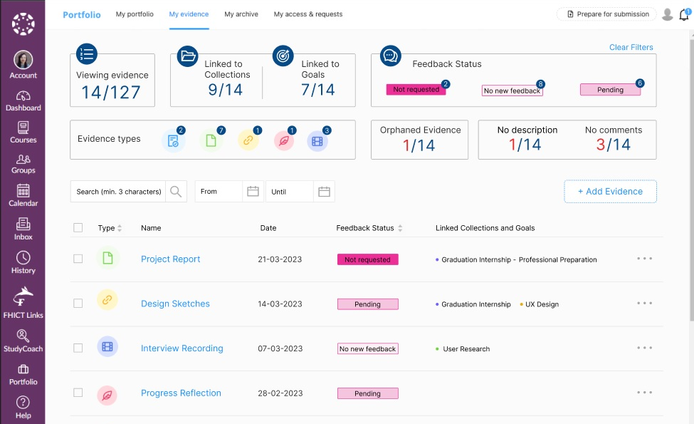
Design Wireframe Version 7

Slide 12
DEMO
Or a pic or a recording of the progress so far

Slide 13
The Challenges

Slide 14

Lonely Start
Mentor on holiday
Setting up the environment
Research and Analysis
Shyness and fear of disturbing people
New Frameworks
React, Ruby course
Custom components
New tools
More complex setting
Mentor Change
Rather unexpected
Well organised
Yet got me worried
Slow development
Difficulty with new frameworks
Need more Peer programing or course practice

Slide 15
What is next?

Slide 16



Development and Deployment
Develop the design Complete Project Report
Submit the portfolio
Testing and Feedback
Enabling access for some end users
Gathering feedback from end-user
Wrap-Up
Handover
Prepare final presentation
Assessment

Slide 17
Thank you!

